Slide 1
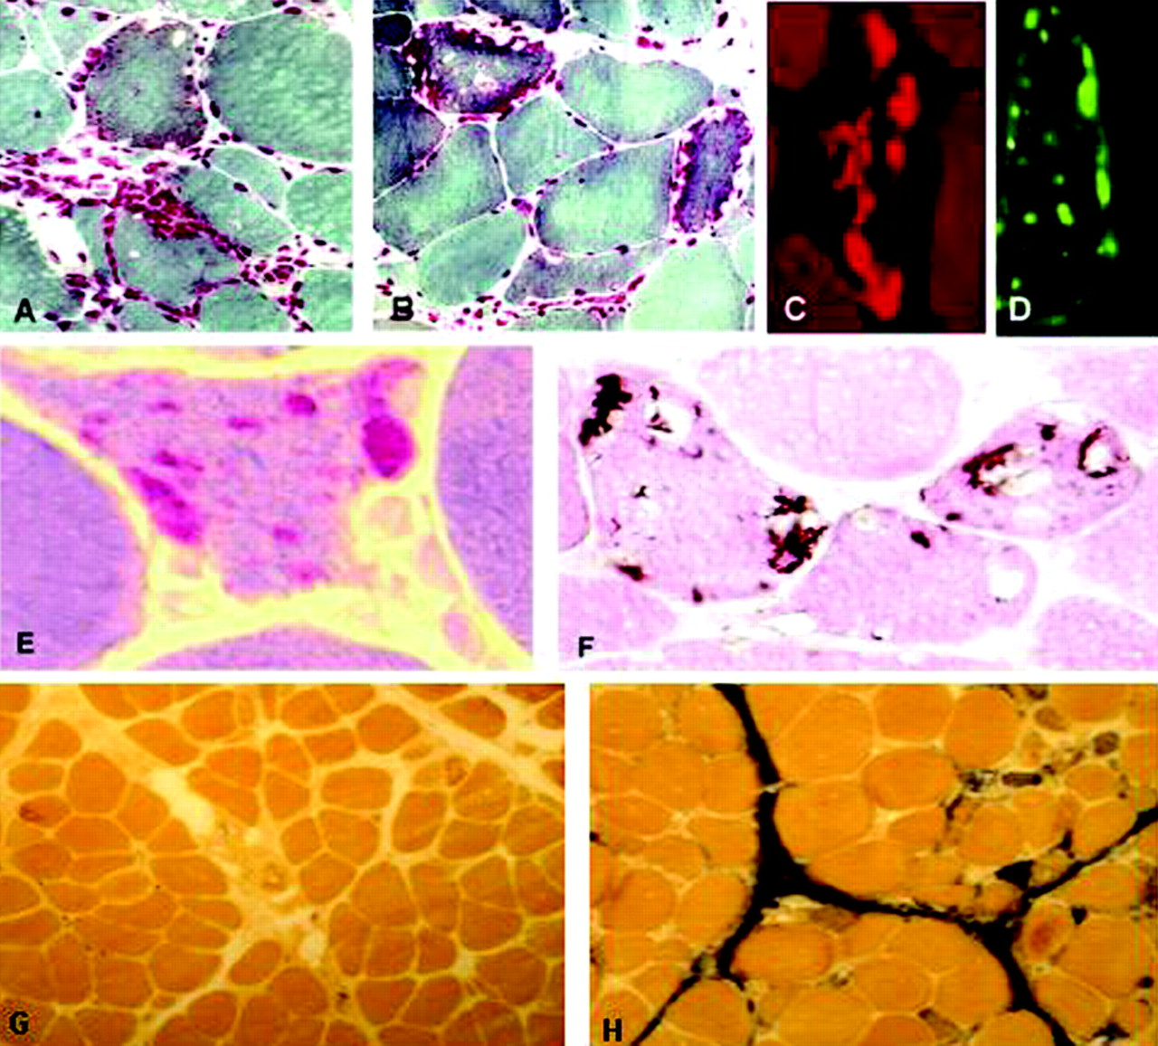
Inclusion Body Myositis
By Russell Diggs
University of North Texas

Slide 2
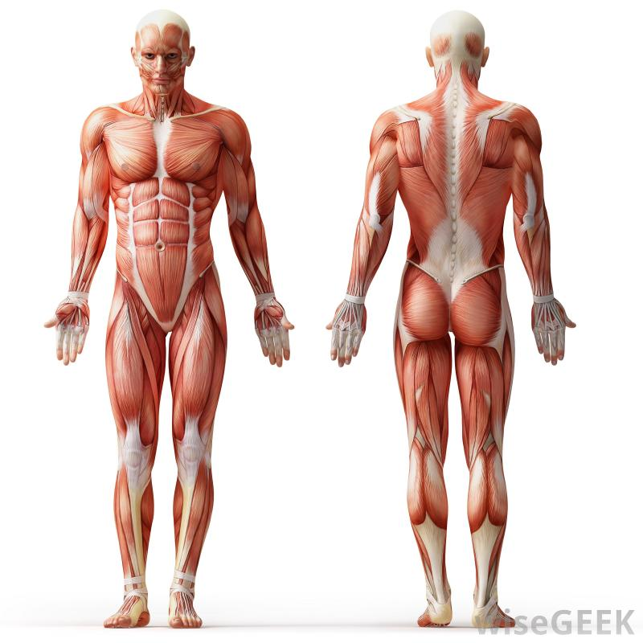
What is IBM?
Inflammatory Muscle Disease characterized by slow and progressive muscle degeneration.
Affects both Proximal and Distal limbs.

Slide 3
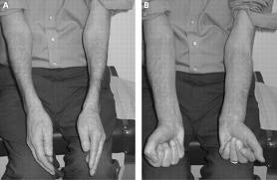
Signs of IBM
Frequent falls
Trouble standing
Difficulty swallowing
Weakened hand grip
Muscle weakness

Slide 4
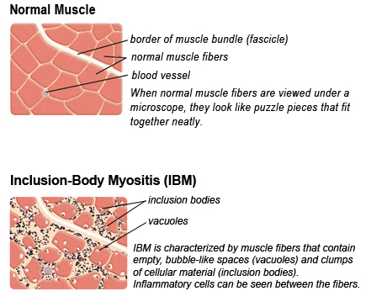
Types of IBM
Sporadic
Hereditary

Slide 5
Star Babbs

Slide 6
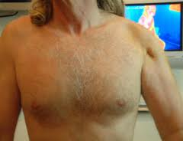
Characteristics of IBM
Muscle Atrophy
Slow but Progressive weakened muscles
Dysphagia (40-66%)

Slide 7
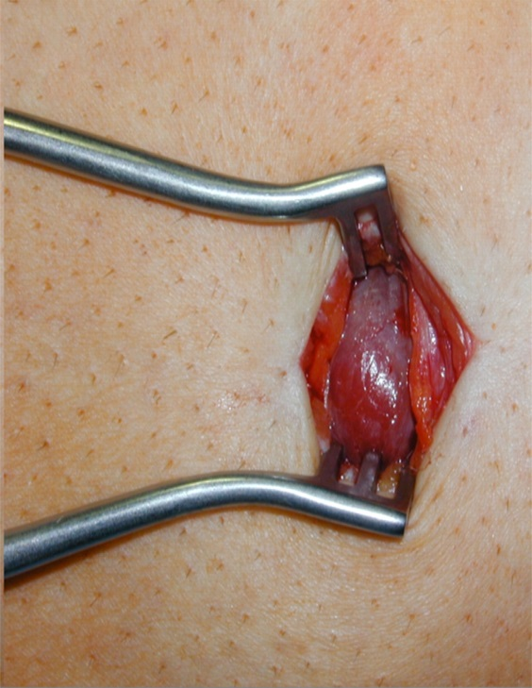
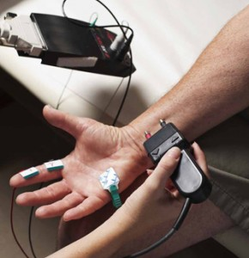
Diagnosis
Muscle Biopsy, Nerve Conduction Test

Slide 8
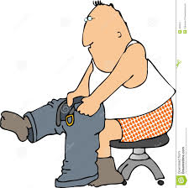
Living With IBM
ADLs

Slide 9
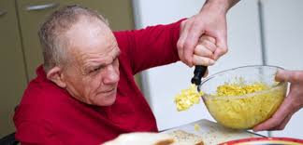
Treatment

Slide 10
Facts about IBM
Most commonly targets people age 50 and above.
More common in males than females
Non- fatal disease, however has the possibility of complications with Dysphagia

Slide 12
Where lives are changed

